Slide 1
Physics 201
Winter 2013
Gravity

Slide 2

Newton’s law of gravity
Winter 2013
Principia = “Mathematical Principles of Natural Philosophy” by Isaac Newton – 1687, 1713, 1726
First 20 pages or so are surprisingly readable
Introduced the three laws of motion and the universal law of gravity:
Used to derive basic dynamics of the Solar System
Show me

Slide 3
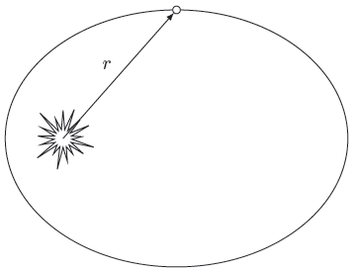

Gravity is universal, but usually is applied to one big object
Winter 2013
The gravitational constant is the least accurately measured physical constant
Astronomy cannot measure mass directly, only GM
Object | GM in SI units
Sun
Earth
Moon

Slide 4
Identification of gravity and weight historically significant
Winter 2013
The very concept of weight is fairly modern
  Aristotle: All things have their place; center of earth = center of universe; planets in circles = axiom
  Middle Ages began to question these assumptions and develop the idea of “gravity” – then Copernicus
Newton: celestial motion can be described with the same laws as terrestrial motion (i.e. force)
  First great “unification” moment in physics
  Erosion of medieval worldview ➔ Enlightenment

Slide 5

Weight is gravitational
Winter 2013
Weight is a force not due to contact – which is unusual (easy to consider it “intrinsic”)
Using Newton’s formula, we can calculate the acceleration due to gravity
This means an object will weigh one-sixth of its normal value on the moon, for example
Show me

Slide 6


Kepler’s third law
Winter 2013
Consider a planet in uniform circular motion – gravity provides the centripetal force:
This allows us to relate orbital period to mass:
Show me

Slide 7
How far away is the Sun?
Winter 2013
This is a surprisingly difficult question
The root of our ignorance is that we don’t have a benchmark (cf. “standard candle”)
Planetary transits ➔ parallax (1639, 1771)
Modern radar measurements are now possible:
With Kepler’s third law we can determine GM

Slide 8
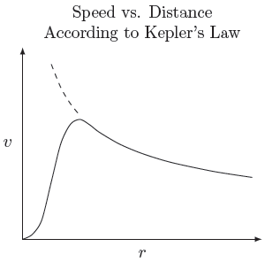
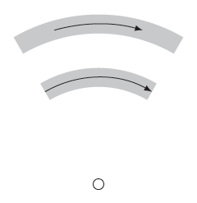
More applications:
Saturn’s rings and dark matter
Winter 2013
Rings of Saturn
Dark Matter
Observed speed of stars in galaxies are too high
Kepler’s law will tend to tear objects apart
Kepler’s law is not valid in galactic core

Slide 9
Road to general relativity
Winter 2013
Long range force is “spooky” – requires field
But special relativity restricts field speed – general relativity completes this correction
Several layers
  First approximation = Newtonian gravity
  Second approximation = Gravitomagnetism
  Final approximation = Black holes and Big Bang

